Slide 1
Task 2: Image Generation Internship
Siri Chandana| 16-09-2025
[Image Generation/ CODECRAFT ]

Slide 2
Introduction
Task 2 focuses on creating imaginative and creative images using specific prompts.
The objective is to explore visual storytelling, experiment with different themes, and enhance skills in designing engaging and visually appealing content.

Slide 3
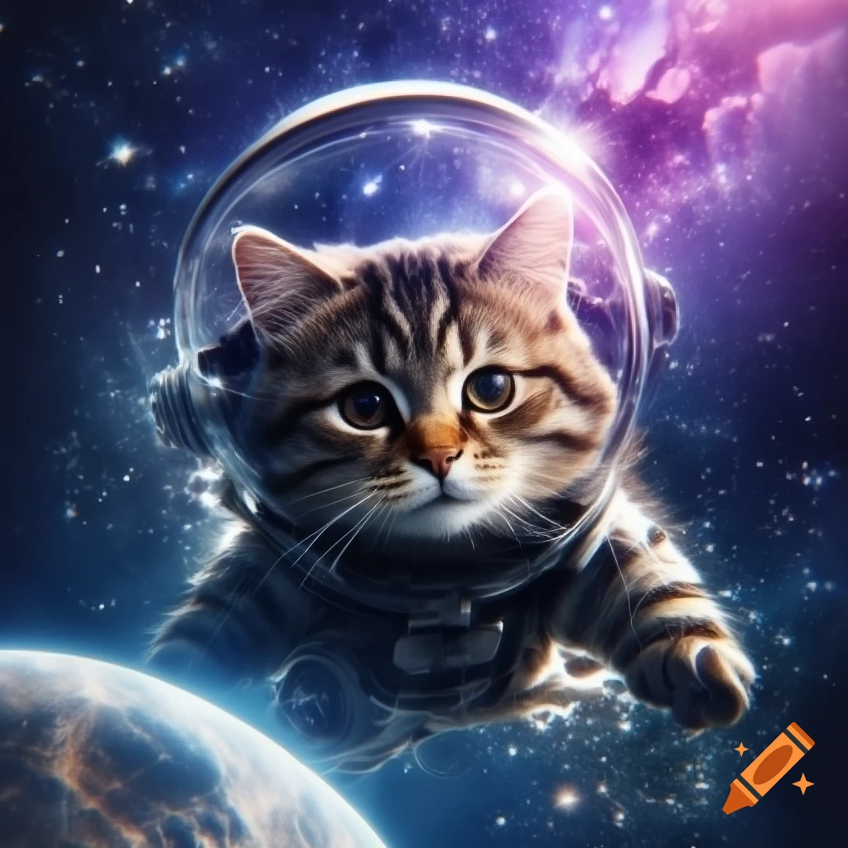
Image 1
Prompt: "A cat astronaut floating in spcae“
Description: “Cat astronaut floating in space, wearing tiny spacesuit and helmet, surrounded by stars and planets, playful and curious, cosmic background.”

Slide 4
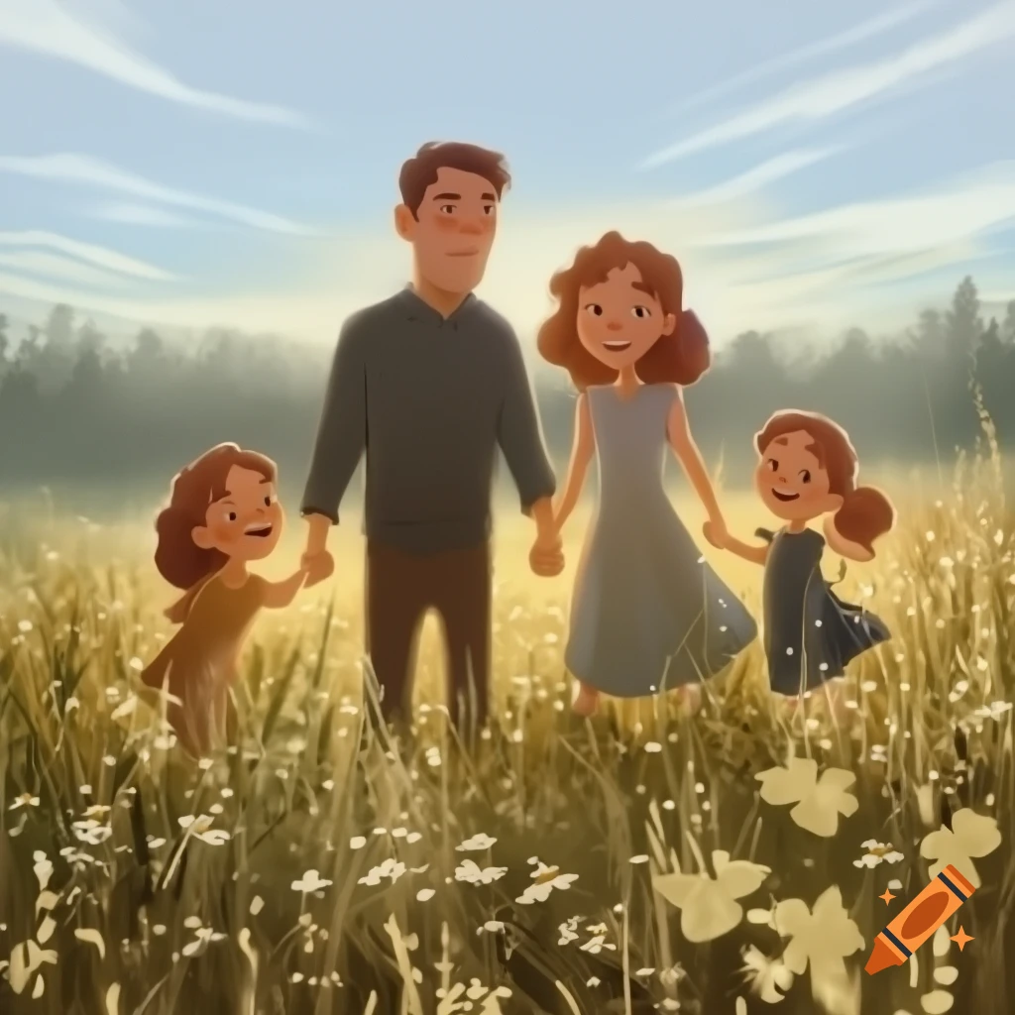
Image 2
Prompt: "A family of father,mother and 2 daughters“
Description: “A happy family consisting of a mother, father, and two daughters, standing together in a warm, cheerful setting. They are smiling, holding hands, and radiating love and togetherness. The background is bright and inviting, emphasizing a cozy, joyful family moment.”

Slide 5
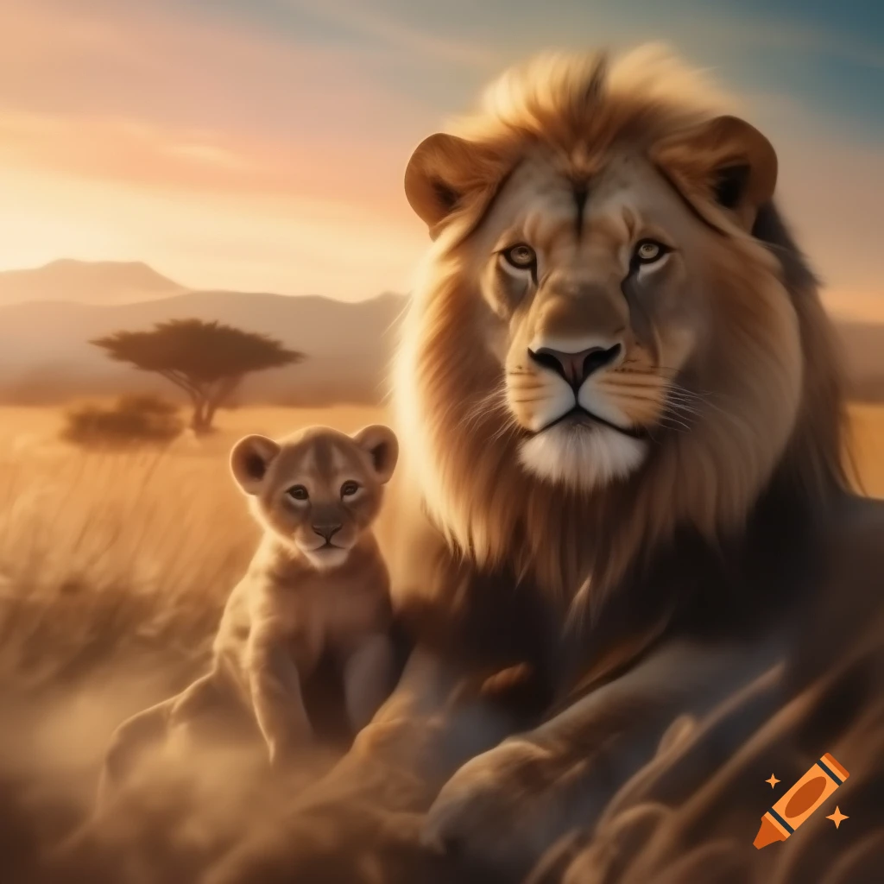
Image 3
Prompt: "Lion with cub“
Description: “Lion with cub in the wild, golden sunlight, playful and protective, natural setting.”

Slide 6
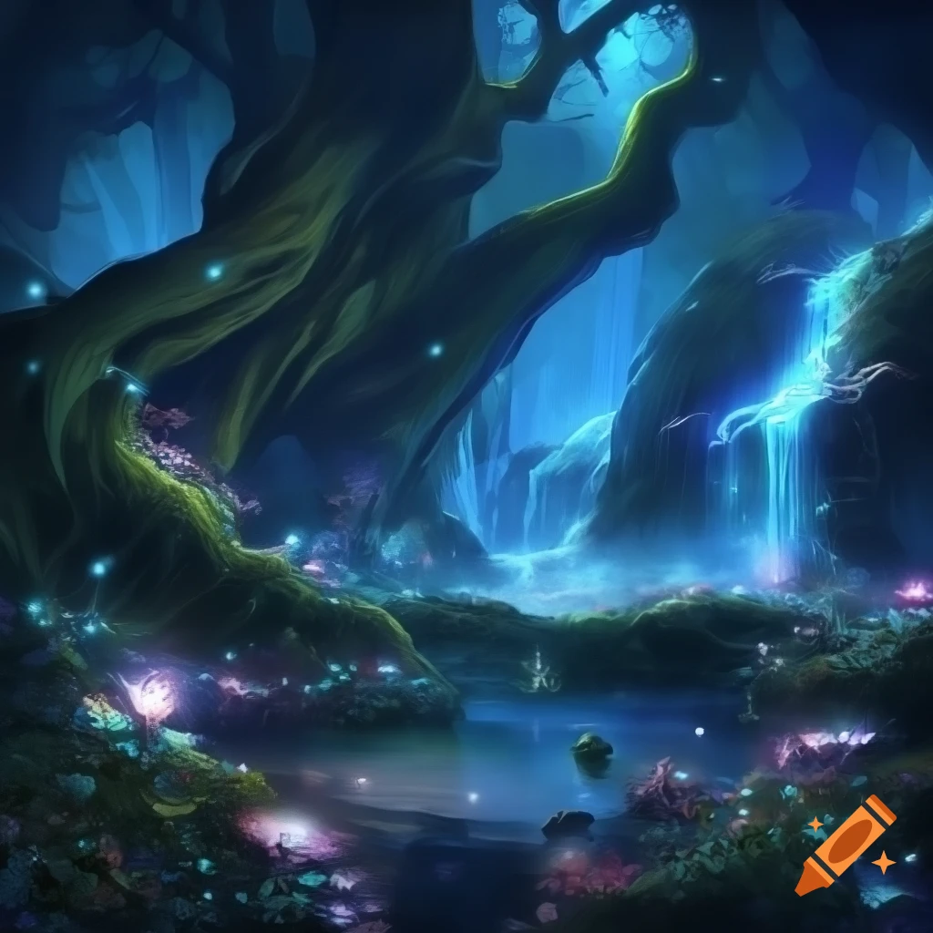
Image 4
Prompt: "A magical forest with glowing plants and waterfalls“
Description: “A magical forest filled with glowing plants and flowers, shimmering softly in the twilight. Crystal-clear waterfalls cascade into sparkling pools, surrounded by mist that catches the light. Enchanted creatures peek through the foliage, and the atmosphere is serene, mystical, and full of wonder.”

Slide 7
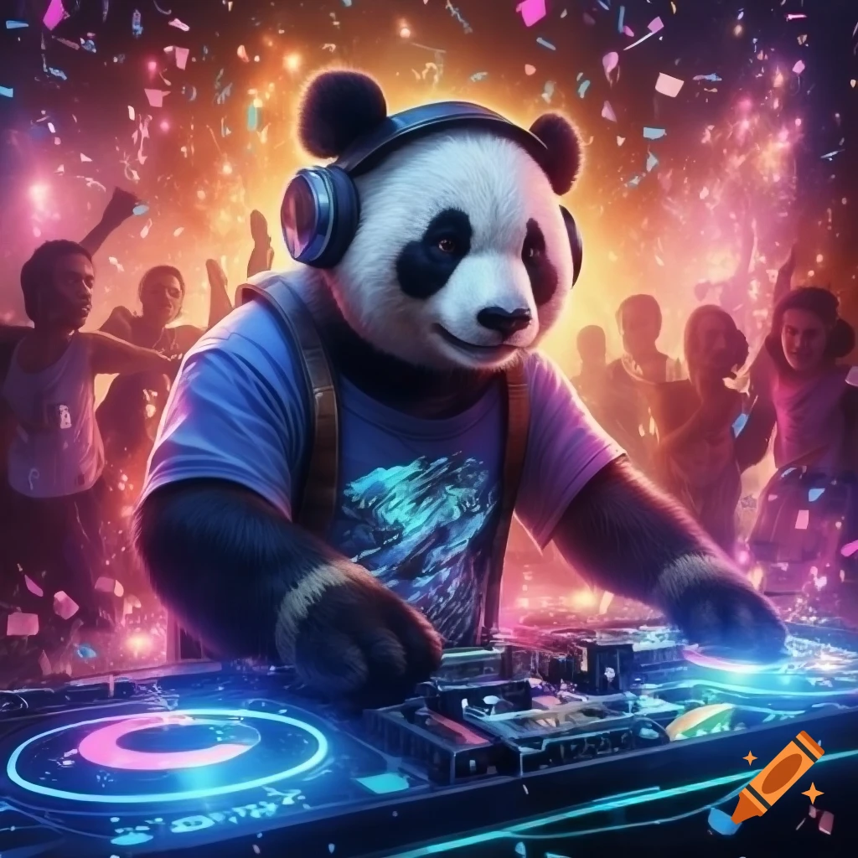
Image 5
Prompt:"A panda dj playing music at party“
Description: “A lively panda DJ spinning energetic tracks at a colorful party, wearing cool headphones and sunglasses, with paws on the turntables. Neon lights flash around, confetti fills the air, and a crowd of dancing animals grooves to the beat. The scene is vibrant, playful, and full of music-fueled energy.”

Slide 8
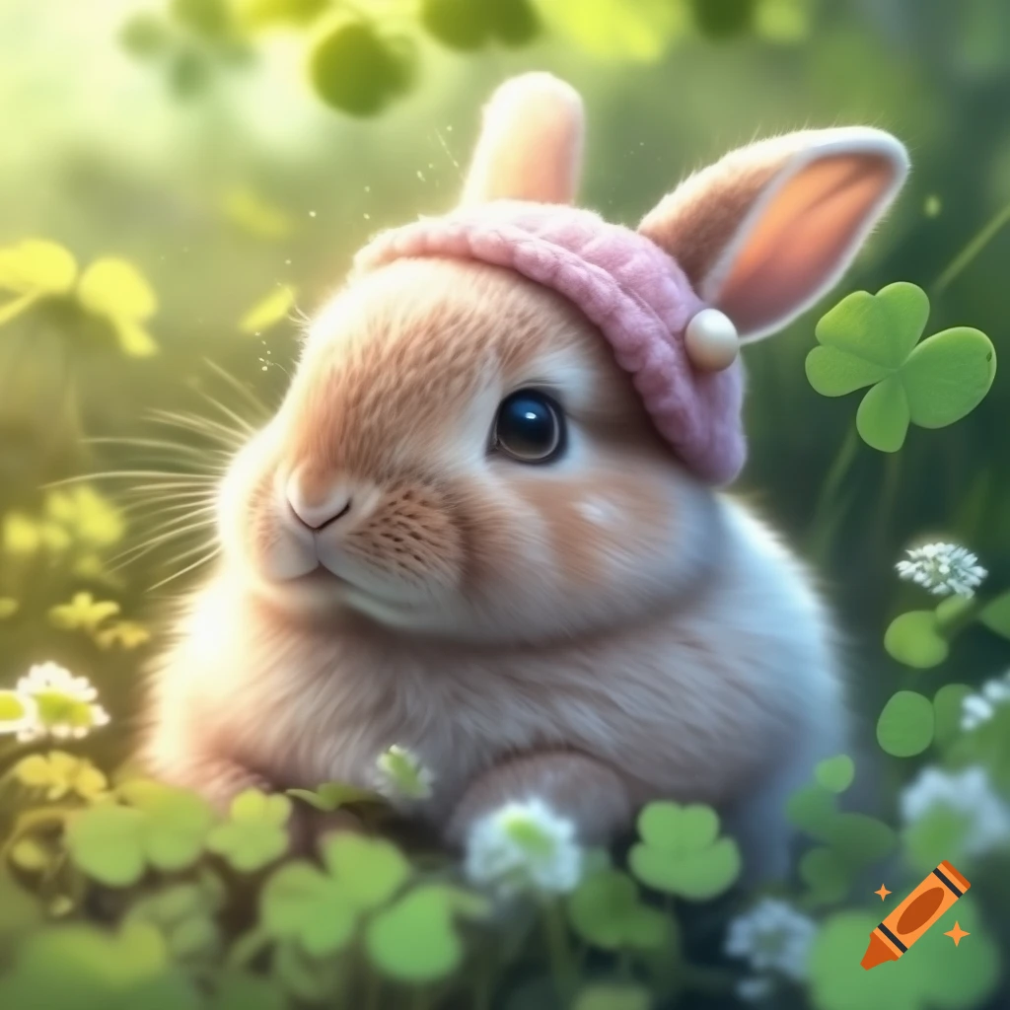
Image 6
Prompt: A cute rabbit with pink hat
Description: “A fluffy, adorable white rabbit wearing a soft pink hat, with big sparkling eyes, tiny twitching nose, and long ears peeking out. The rabbit looks cheerful and playful, sitting on a patch of green grass with a gentle, sunny background."

Slide 9
Conclusion
Task 2 successfully demonstrates the creation of imaginative and visually engaging images.
Each image highlights creativity and effective visual storytelling, showcasing the ability to translate concepts into compelling visuals.

